Slide 1

Pay-Per-Click Advertising

Slide 2
Getting Started
Very Easy to Set Up
Take the time to
  Plan
  Research
  Setup
  Execute
  Track Results

Slide 3
1st Step: Budget and ROI
Define program objectives
What’s success?
How will you measure success?
Define and set conversion expectations

Slide 4
Conversions
Any interaction that you want to track
Valuable events like:
  Product Purchase
  Form Completion
  White Paper Download
  Event Registration
  Inquiry

Slide 5
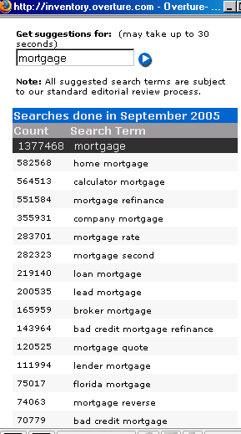
2nd Step: Research Keywords
Yahoo Search Marketing
  Keyword Selector Tools
  Keyword Bid Tool
  ROI Calculator
Google
  Keyword Lookups
  Keyword Analysis
  Traffic Estimator
Wordtracker.com

Slide 6
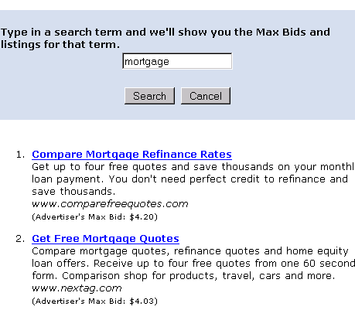
Bid Example

Slide 7
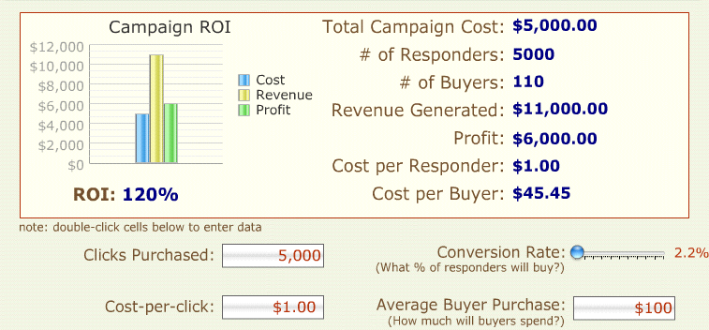
ROI: What’s Each Conversion Worth?
Source: http://www.bplans.com/common/calculators/ppcroi.cfm

Slide 8
How Can You Maximize Your ROI?
Great Ad Copy
Keyword Specific Landing Pages
Improve Conversions
Continually Track What’s Going On

Slide 9
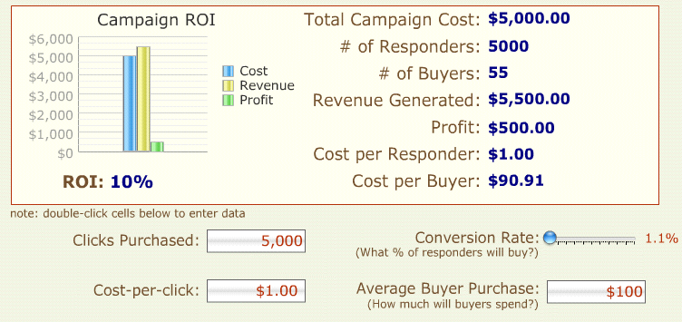
Scenario 2

Slide 10
Copywriting
Focus on Your Ad Copy
  Title
  Body text
  URL
Google lets you run multiple ads
Art more than science
Look at competitors
Hire copywriter

